Slide 1

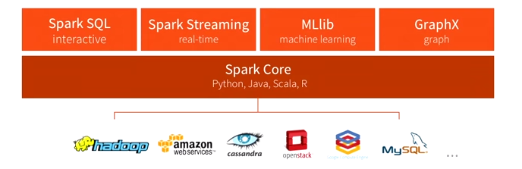
Handling (SQL) Queries in Spark

Slide 2
What is Spark SQL
Spark SQL is Spark’s API for working with Structured and semi structured dataset.
Integrates with Spark RDDs seamlessly
Unified Data Access (support for JSON, Parquet, CSV, MongoDB, Hive, Relational datbases) and HDFS.
Support for traditional Database access via JDBC/ODBC.
https://spark.apache.org/sql/
Notes:
https://databricks.com/blog/2015/03/20/using-mongodb-with-spark.html

Slide 3
Data Frames
Data Frames (DF) are RDDs with schema.
Integrates well with RDDs
Convert DF into RDD using df.rdd
DFs contain elements of type Row
DFs contain schema (Columns) which can be manipulated by APIs.
You can create a DF as follows:
Create from an RDD using the toDF()
Create a DF from a source files (JSON, .CSV etc)
Create a DF from Hive, Mongo and others using connectors
Create a DF from JDBC/ODBC

Slide 4
Loading JSON Files
val sc: SparkContext // An existing SparkContext.
val sqlContext = new org.apache.spark.sql.SQLContext(sc)
//Version 1.4 - use this syntax
val df = sqlContext.read.json("/user/cloudera/people/people.json").cache()
//Version 1.3 - use this syntax
val df = sqlContext.jsonFile("/user/cloudera/people/people.json").cache()
df.show()
Ex: spark-sql-json.scala
Dataset: people/people.json
Code – Also available at Github: https://github.com/snarendran/hadoop/tree/1.0

Slide 5
Loading CSV File
No inbuilt support for loading .CSV file yet
Need to load jars from databricks
Ex: spark-sql-csv.scala
Dataset cars

Slide 6
Using RDDs to create DF
RDDs are good at reading .csv files. So, leveraging them would be a good alternative.
Code:Spark-sql-csv2.scala
Data:emp

Slide 7
Data Frames – Options for Transformation
Option 1:
You can use Database APIs like Join, Select, Filter, GroupBy etc on a DF
Option 2:
You can register a DF as a temporary table and use SQL semantics
Option 3:
You can use HiveContext to manipulate data
Note (Option 4): You can also do transformations (join, filter map etc) on basic RDDs (as seen in earlier examples) and achieve the same results.

Slide 8
Data Frame Transformation – Option 1
You can use transformations such as filter, select, groupBy etc on Data Frames.
Ex1: spark-sql-df-1.scala (dataset:json)
Ex1: spark-sql.df-2.scala (dataset : Emp)

Slide 9
Data Frame Transformation – Option 2
You can register DF in a temporary table and use SQL syntaxes to query the same.
The result of the query will be a DF.
Code: spark-sql-df –temp-table.scala
Dataset: Emp

Slide 10
Data Frame Transformation – Option 3
Use the Hive Context to connect to Hive
val hc = new org.apache.spark.sql.hive.HiveContext(sc)
All Hive Syntaxes would be applicable
Configure Hive access via Spark (see next page)
Ex: spark-sql-hive-df-1.scala (dataset comments)
spark-sql-hive-movies.scala (dataset: Movie Data)

Slide 11
Configuring Hive access from Spark
Sandbox Setup:
cp /etc/hive/conf/hive-site.xml /etc/spark/conf
vi /usr/lib/spark/bin/compute-classpath.sh (Sandbox)
// Add the following line at the end of the file.
CLASSPATH="$CLASSPATH:/usr/lib/hive/lib/*“
Start spark-shell again
In Hive shell-
Set hive.execution.engine=spark’;
Google Cloud Setup:
cp /etc/hive/conf/hive-site.xml /etc/spark/conf
Vi opt/cloudera/parcels/CDH/lib/spark/bin/compute-classpath.sh
// Add the following line at the end of the file
CLASSPATH="$CLASSPATH:/usr/lib/hive/lib/*"
// Restart the spark clusters

Slide 12
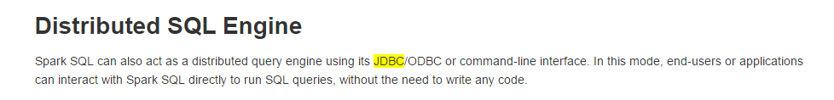
Drill – A Powerful Execution Engine
A Schema Free Query Engine based on Apache License
https://drill.apache.org/
https://drill.apache.org/docs/drill-in-10-minutes/
Drill-movies.sql
Drill-hello-world.sql
https://spark.apache.org/docs/latest/sql-programming-guide.html#jdbc-to-other-databases

Slide 13
OLAP on Hadoop –Competing Architectures
Visualization Engines – Tableau, Qlikview, Excela, MSTR
Platfora, ZoomData
ODBC
JDBC
ODBC
SQL Interface , CTAS :
Hive (HQL)
Drill
Spark SQL
Execution Engines
Spark
MR
Tez
Drill - MPP
Unified Data Access Layer
Hadoop – Hive, HBase
RDBMS
Text Files (JSON, XML, CSV)
NoSQL

Slide 14
 | Drill 0.6 | Impala 1.x | Hive 0.13 w/ Tez | Spark SQL
Latency | Low | Low | Medium | Low for in-memory Medium for on-disk
Concurrency | Medium | Medium | Limited | Limited
Files support | Yes (all Hive formats) Optimized formats (Parquet, JSON, Text) | Yes (Parquet, Sequence,RC,Text, AVRO …) | Yes (all Hive file formats) | Yes (all Hive file formats) Optimized formats (Basic Parquet, JSON)
HBase/MapR-DB | Yes | Yes, Performance issues | Yes, Performance issues | Same as Hive
Hive compatibility | High | Medium | High | High
Schema | Schema-less or Hive or HBase | Hive | Hive | Hive, rudimentary schema-less
SQL support | ANSI SQL | HiveQL (subset) | HiveQL | Rudimentary ANSI SQL & HiveQL
Client support | ODBC/JDBC | ODBC/JDBC | ODBC/JDBC | ODBC/JDBC
Large datasets | Yes | Limited | Yes | Yes
Nested data | Yes | No | Limited | Limited
Transactions | No | No | No | No
Optimizer | Limited | Limited | Limited | Limited
Source: MapR
http://apachesparkcentral.com/category/spark-odbc-driver/

Slide 15
The choice for BI Tools
BI Tools->(ODBC/JDBC)-> Hive ->MR/Spark/Tez
Deployment is close to SQL semantics
UDF, SerDes etc available
Can take advantage of pipelining (Spark as execution engine)
Cannot take advantage of caching (yet)
BI Tools->(ODBC/JDBC)->Spark SQL-> Hive and other Data sources:
Can take advantage of Spark semantics such as Caching, Pipelining , RDDs etc
How does JDBC provide caching() semantics?
What about UDFs and SerDes?
Hive on Spark (or) Hive on Tez?

Slide 16
Hive on Spark (or) Hive on Tez
Spark (open-source, but backing by Databricks, Intel & partly by Cloudera. Adoption by IBM)
Tez (Hortonworks, Hortonworks, MSFT)
Impala (Cloudera)
Drill (Open Source)
Hive on Spark - Blazing Fast or is it http://www.slideshare.net/hortonworks/hive-on-spark-is-blazing-fast-or-is-it-final
(Hortonworks)
https://gigaom.com/2014/07/20/spark-and-tez-out-of-phase/

Slide 17
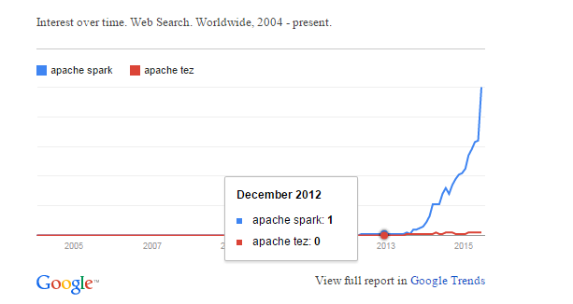
Deciding the Winning Stack
Current Adoption of SQL in Big Data community is confusing.
No clear winner yet.
Why adoption is a key metric for investment?

